Slide 1
The Disciplines of Leadership
Adding Some Tools To Your Repertoire
February 1, 2014

Slide 2
Leadership is a skill.
It can be learned and improved, it is never static.

Slide 3
What We Will Cover
I. What is leadership?
By Definition
What Makes A Great Leader
Discussion of Leaders
II. Motivating Others
Styles of Leadership
The Disciplines of Leadership
Relevancy to Kiwanis

Slide 4
What Is Leadership?
“A leader is someone who has followers.”
-Peter Drucker
“Leadership is the ability to translate vision into reality.” -Warren Bennis
“Leaders in the next century will be those who empower others.” -Bill Gates
“ Leadership is influence….nothing more, nothing less.” -John Maxwell
Notes:
John Maxweil

Slide 5
Perfect Definition for Kiwanis!
Leadership is the art of influencing the actions of others toward the achievement of a common goal.
Notes:
Focus on:
Art – its not a science and like beauty, leadership is in the eye of the beholder
Influence – leadership is about influencing, not dictating outcomes
Action – leaders get things done through others

Slide 6
What Makes A Great Leader?
To influence people requires excellent
“RELATIONSHIP MANAGEMENT”
……how do you achieve it?

Slide 7
What Makes A Great Leader?
It Starts With Self-Awareness
Being aware of your own emotions as they happen, and keeping on top of how you tend to respond to them.
Having a deep understanding of your strengths, limitations, values and goals.
Notes:
Accurate self assessment: knowing your values and strengths): Warren Buffet was asked to speak to a group of university students. He told them that there was really no difference between them and him. Hearing this from one of the world’s richest men, the students (who could barely cover their phone bills) laughed. He continued, “I may have a little more money than you, but if there is any difference, it might be this – I get up every morning, and have an opportunity to do what I love the most – analyze markets and individual companies. If there is anything you can learn from me, this is it!” He was so aware of what he really loved, that is he made his interest the centerpiece of his whole professional career. Winston Churchill, Mother Teresa and many others are examples of people who used the knowledge of self awareness and built their lives around what was most important to them. More modern examples are people such as Bono and Oprah Winfrey. Ask the participants if they know anyone who they believe does what they value / enjoy most?
Self Management –Self Management is what you do with the knowledge of self awareness: A deeper knowledge of your values, strengths and weaknesses guides your actions. Being aware of your own emotions as they happen gives you the opportunity to do something with them and to positively direct your behaviour. If you know what stimulus tends to get you upset and angry, you might be able to redirect your behaviour the next time you experience that stimulus.
Example 1: Provide a story depicting someone who was so aware of their deeply held values that they knew exactly what to do in a difficult situation.
Example 2: Provide a story to show how awareness of own emotions, or the lack of them can affect behaviour

Slide 8
What Makes A Great Leader?
Next Step Is Self-Management
The ability to use awareness of your emotions
to stay flexible and positively direct your behavior. This means managing your emotional reactions to all situations and people.
Notes:
----- Meeting Notes (1/31/14 21:40) -----
here show video

Slide 9
What Makes A Great Leader?
Then, Social Awareness
The ability to accurately pick up on emotions in other people and get what is really going on. This means understanding what other people are thinking and feeling even if you don’t feel the same way.
Notes:
Social Awareness is about picking up on the needs and emotions in other people.
Are we able to see the emotions behind a person’s stance in meetings?
Do we understand people from different cultures? How diverse is our own growing-up experience?
Being sensitive and aware of other’s difference and resisting the urge to stereotype is important and people who are successful at this allow themselves the opportunity to learn from others rather than judging or turning a blind eye to differences.
Relationship Management –Relationship Management is where it all comes to bear. It is about using all the knowledge of the first three concepts to manage interactions successfully.

Slide 10
What Makes A Great Leader?
Finally, Relationship Management
The ability to use awareness of your own
emotions and the emotions of others to manage interactions successfully. Letting emotional awareness guide clear communication and effective handling of conflict.

Slide 11
Elizabeth I

Slide 12
What Made Her A Great Leader?
Elizabeth I:
Had a vision for Britain
Was passionate about her mission
Gained trust by knowing the needs and wants of her people and visiting dignitaries
Motivated her subjects to fight for their country
Notes:
E1 had a difficult childhood to say the least. Her ascendancy to the throne was after her half sister Mary who continued the religious policies set by their father, Henry VIII which tore the country apart. She was the monarch who brought peace between Catholics and protestants.
One of my favorite stories about her is that when the Spanish Armada was at their shores Eliz suited up in armor, went to the front line and gave a rousing speech to the troops.

Slide 13
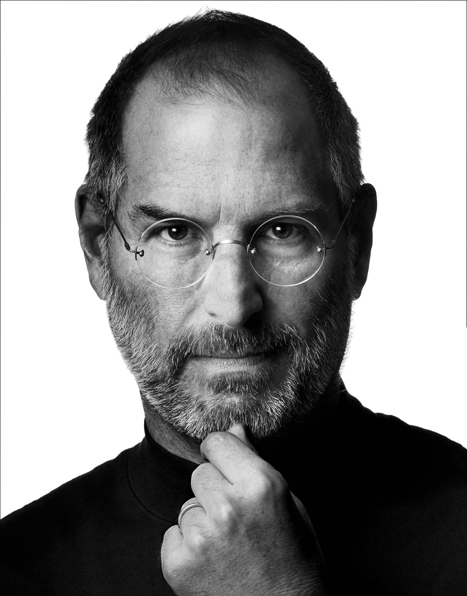
Steve Jobs

Slide 14
What About Steve Jobs?
Totally dedicated to the vision for Apple
Passionate about the company
Able to inspire trust in investors and many employees
Motivated team to create and innovate
Was intimately involved in the day-to-day
Notes:
Sometimes leaders have to make tough choices.

Slide 15
George W. Jenkins
Notes:
Altho he died in 1999 there are still employees who remember him and revere him.

Slide 16
And A Florida Legend, Mr. George
Had a vision for better grocery stores
Was passionate about the importance of the people he employed
Engendered loyalty in his employees and customers
Motivated stakeholders by making them owners
Visited stores virtually daily

Slide 17
Different but Similar
All had a vision:
Elizabeth to bring unity to Britain
Steve Jobs to create the best home computer
George Jenkins to create the best grocery chain
All three were passionate
Elizabeth risked her life
Steve Jobs risked the friendship of some employees
Mr. George persisted in the Great Depression

Slide 18
Similarities…
All engendered trust and loyalty*
Elizabeth in her subject and court
Steve Jobs in employees and investors
Mr. George in his employees and customers
Experts in motivation
Elizabeth with her military
Steve Jobs with his staff who worked 24 hours!
George Jenkins motivated his employees with ownership
*Relationship Management

Slide 19
Similarities…
They participated in the trenches
Elizabeth actually went into battle
Steve Jobs slept in the office
George Jenkins visited stores every day
Notes:
Name others who were great leaders….(Mandela, Mother Teresa, Bono, Churchill, Gandhi)

Slide 20
Motivating Others
Styles (Tools) of Leadership
The Disciplines Needed
Relevance to What We Do
“Name That Style!”
Questions and Comments

Slide 21
Styles of Leadership
Its not about your needs but the needs of the people and organization.
Styles can be adapted to the particular situation you are facing. (situational)
Effective leaders have the following styles in their repertoire to use as needed.

Slide 22
Styles of Leadership*
Commanding: Provides clear directions with focus on specificity, clarity and one direction for clearly defined outcome
Coaching: Seeks to learn how an individual’s goals and interests can best align with the task / project at hand and point them in the right direction
Affiliative: Connects people, emphasizes teamwork relationship building to enhance individual performance; strives to build / maintain high morale
Democratic: Focuses on harnessing the power of the group to build consensus and move people forward
* Daniel Goleman, “Primal Leadership”
Notes:
These are in order of how you would introduce them for situational leadership on the next page.
Commanding – low skill/low will.
Coaching – low skill, high will
Affiliative – high skill, low will
Democratic – high skill, high will

Slide 23
Situational Assessment
 | Skill
Will | Low Skill / Low Will As a result of lack of knowledge or experience, one may be overwhelmed by a task or find it difficult to know how to make an impact | High Skill / Low Will Ready, willing and able but not skilled or experienced to be left on their own
 | Low Skill / High Will Experienced and skilled, but lacks the motivation due to either burn out or possibly negative feedback the last time the task was assigned | High Skills / High Will Step aside and let the experience and motivation lead
 | Low High
Notes:
SITUATIONAL LEADERSHIP IS STRICTLY TASK ORIENTED, NEVER LABEL PEOPLEAND PUT THEM IN A BOX AND NEVER USEADJECTIVES THAT DESCROIBE TRAITS OF PEOPLE – SMART, ARROGANT, TOXIC – THIS IS DANGEROUS IN A PRESENSTATION LIKE THIS. ADDITIONALLY, ‘SMART’ IS NOT AN ACCURATE DESCRIPTOR FOR PEOPLE’S CAPABILITIES. LOTS OF ‘SMART’ PEOPLE ARENT SKILLED AND LOTS OF NOT VERY BRGHT PEOPLE ARE HIGHLY SKILLED IN CERTAINS TASKS.. THIS MUST BE TAUGHT AS ONLY TASK ORIENTED SITUATIONS. PEOPLE LEARN CHANGE AND DEVELOP. THAT HAS TO BE THE MAIN FOCUS WHEN DISCUSSING SITUATIONAL LEADERSHIP

Slide 24
Styles of Leadership (Con’t)
Pacesetting: Sets high performance standards and drives people (hard) to achieving goals
Visionary: Defines and articulates shared set of goals; can see where team needs to move and allows for input and innovation as to how to accomplish those goals
Notes:
THESE LAST TWO STYLES ARE LESS SITUATIONAL MANAGEMENT AND MORE TACTICAL (PACESETTING) OR LONG-TERM (VISIONARY). THESE TWO STYLES SHOULD BE USED SPARINGLY AT THE RIGHT MOMENT IN TIME FOR THE TASK AT HAND. LEADERS WHO RELY SOLEY ON PACESETTIN BURN PEOPLE OUT BY SETTING HIGH GOALS AND PUSHIN PEOPLE TOO HARD FOR TOO LONG. VISIONARY LEADERS CAN SPEND ALL DAY THINKING AND PLANNING FOR THE FUTURE BUT THEY NEED TO GET THINGS DONE.
TO USE A GOLF ANALIOGY, THE PREVIOUS 4 STYLES ARE LIKE YOUR DRIVER, YOUR PUTTER AND TWO OF YOUR FAVORITE IRONS. GREAT GOLFERS, LIKE GREAT MANAGERS, CAN PLAY A PRETTY DECENT GAME WITH ONLY 4 CLUBS. HOWEVER, WHEN YOU NEED A SAND WEDGE AND A HYBRID DRIVER FOR THE SPECIALITY SHOTS OR PARTICULARLY TOUGH COURSES, YOU AS A LEADER WOULD WANT MORE THAN 4 CLUBS IN YOUR GOLF BAG. THESE LAST TWO STYLES ARE LIKE SPECIALIZED CLUBS. THERE TO MAKE YOU A GREAT LEADER, BUT NOT TO BE USED ON EVERY HOLE.

Slide 25
The Disciplines of Leadership?
Have a Vision
Passionate about the cause
Work to gain the trust of stakeholders
“calm is contagious”
The ability to motivate
“In the trenches” involvement
Ability to make the tough calls

Slide 26
How Is This Relevant To Kiwanis?
We have a vision for a better future for the children of the world.
We all are passionate about the mission to help children.
Need to engender trust in other members to participate
We have a need to motivate teams to achieve more
We have to “be there”

Slide 27
Name That Style!
You have asked an experienced member of your team to take the lead on creating new ideas for an upcoming fundraiser. The last one they led had some issues, but you know they have great ideas and it’s a perfect chance to give them another shot. But its been 4 days since your last discussion, and you haven’t seen anything.
What style should you use?
Notes:
Affiliative. In this case, this is a skilled person, but perhaps they are burnt out from the last time they had to do this task OR maybe the last one they did, they got some negative fedback on and are now not willing to take risks. As a leader, you need to see where they are and meet them with the affiliative style. Rebuild them with positive feedback, morale ./ relationship boosting interactions.

Slide 28
Name That Style!
Paul is a technical expert and you are thinking about how to help him grow his skills. For this next project, you’ve asked him to take the lead managing others on the team. It’s been several days and you’ve noticed Paul has made good headway, but has never organized a team meeting.
What’s going on?
Notes:
This may be a hard one for people to see, but this is meant to be an example of low skill/low I(maybe high) will. Paul is a technical expert but new to managing people and it sounds like he has no idea where to start (but does on the project so rather than involve othershe just dove right in). If you play it to the ‘low will’, you want people to take about how maybe given paul;’s techincal strnghts he needs some good direction as to how to lead the people in the project. As his manager, you need to give him some clear instructions as to how he should thinking about managing others. If you choose to take this to the low skill .high will, then coaching is the answer. How can we as managers engage paul in helping him learn how to manges others – ask questions: paul, how will you involve the team, what kinds of meetings will you have, how will you think about delegating tasks, how can I help you

Slide 29
There is a big difference between a boss and a leader. A boss says, “Go.” A leader says, “Let’s go.” The purpose of leadership is to take others to the top. And when you take others who might not make it otherwise to the top, there’s no other feeling like it in the world. To those who have never had the experience, you can’t explain it. To those who have, you don’t need to.
John Maxwell, “Leadership Gold”
Notes:
IS THIS A QUOTE OR A PERSONAL REFLECTION? IF IT’S A QUOTE, YOU SHOULD SOURCE IT. IF IT’S A REFLECTION, I WOULD ADD IT TO YOUR NOTES AND END ON A REAL QUOTE FROM SOMEONE.

